Slide 1







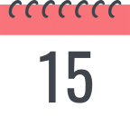



Understanding and Overcoming Procrastination
DATE
July 17, 2023
PRESENTERS
AMAN VERMA

Slide 2




Table of contents
01
What is procrastination
02
Why do people procrastinate?
03
Costs of procrastination
04
Tips and
techniques

Slide 3









Introduction
Procrastination is the act of delaying or postponing a task or set of tasks. It can be caused by a number of factors, including fear of failure, perfectionism, lack of motivation, and a lack of time management skills.

Slide 4


Why do people procrastinate?
Fear of failure: They may be afraid of not being good enough, or of making mistakes.
Anxiety: Feeling of fear, dread, and uneasiness.
Lack of motivation
Lack of time management skills
Avoidance of negative emotions: Procrastinators may put off tasks because they associate the task with negative emotions, such as anxiety, stress, or boredom
Perfectionism: An unwillingness to settle for anything less than perfection.

Slide 5






Work
Personal
How you Crush Procrastination and Take Control of Your Work Life?
How you avoid procrastination
in your personal life?

Slide 6

Cost of Procrastination
Stress and anxiety
Low self-esteem
Poor performance
Financial loss
Personal problems

Slide 7




HOW TO OVERCOMING PROCRASTINATION
Recognize
Set Clear
Time
Set
Procrastination
Goals
Management
Deadlines
Reflect on why you procrastinate. It could be due to fear of failure, lack of motivation, feeling overwhelmed, or even perfectionism
Establish specific, measurable, achievable, relevant, and time-bound (SMART) goals. Break them down into smaller tasks to make them less daunting and more manageable.
Techniques like the Pomodoro Technique can be helpful. Set a timer for 25 minutes of focused work, followed by a 5-minute break. After four sessions, take a longer break.
Plan out your daily or weekly schedule, allocating specific time blocks for working on the project. Be realistic about the time needed for each task, leaving some buffer for unexpected challenges

Slide 8
Strategies to beat procrastination
To do list
or sticky notes
01
Have a routine
04
02
Take a first step
Learn to say no
05
Exercise & Meditate
03

Slide 9

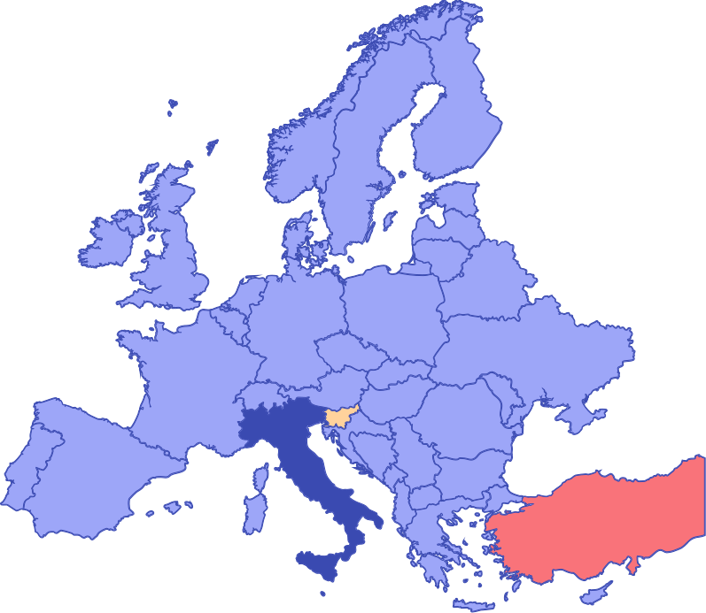
Which countries that have been found to have high rates of procrastination

Slide 10


Which countries that have been found to have high rates of procrastination
Japan
Taiwan
Hong Kong

Slide 11

REMEMBER
Procrastination is a gradual process, and it requires consistent effort and self-awareness. By implementing these strategies and staying committed to your goals, you can improve your time management skills and meet deadlines more effectively.

Slide 12










Thank You :)

